Slide 1
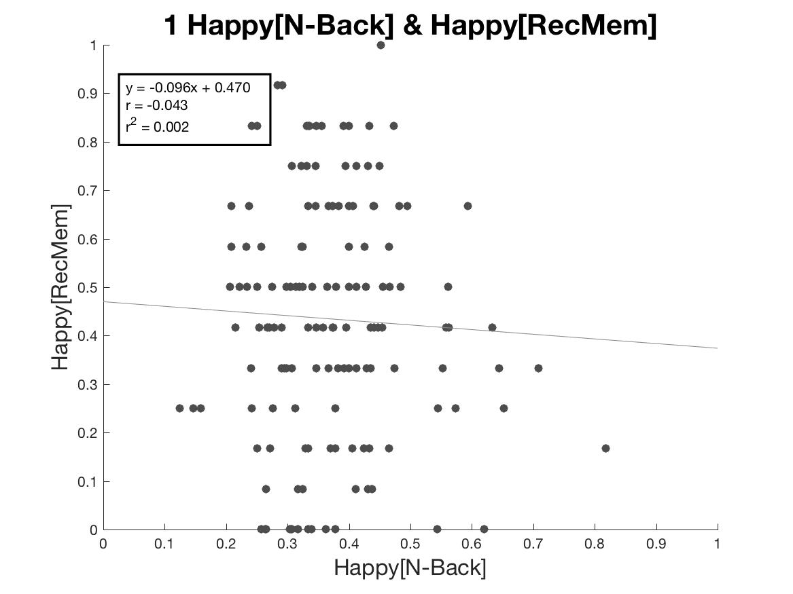
Happy Nback & Happy REC

Slide 2
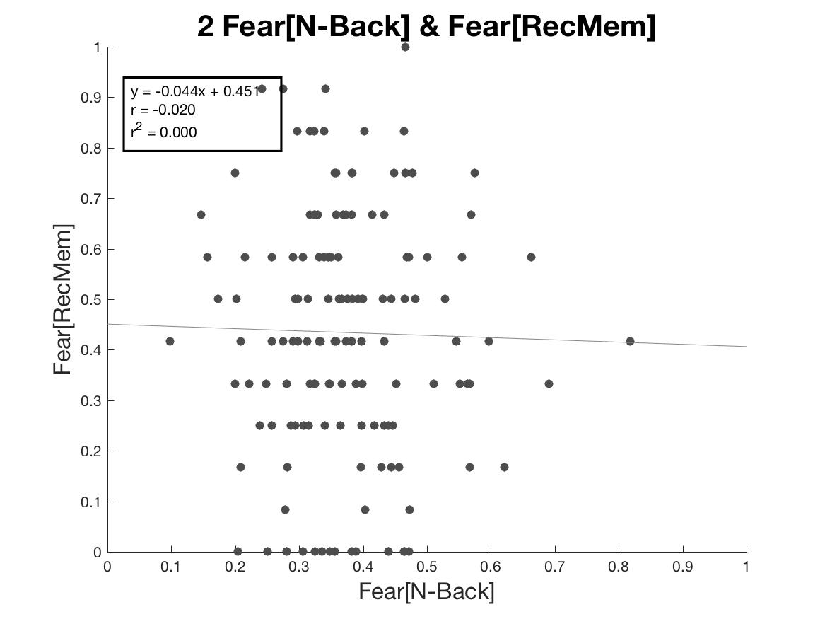
Fear Nback and Fear REC

Slide 3
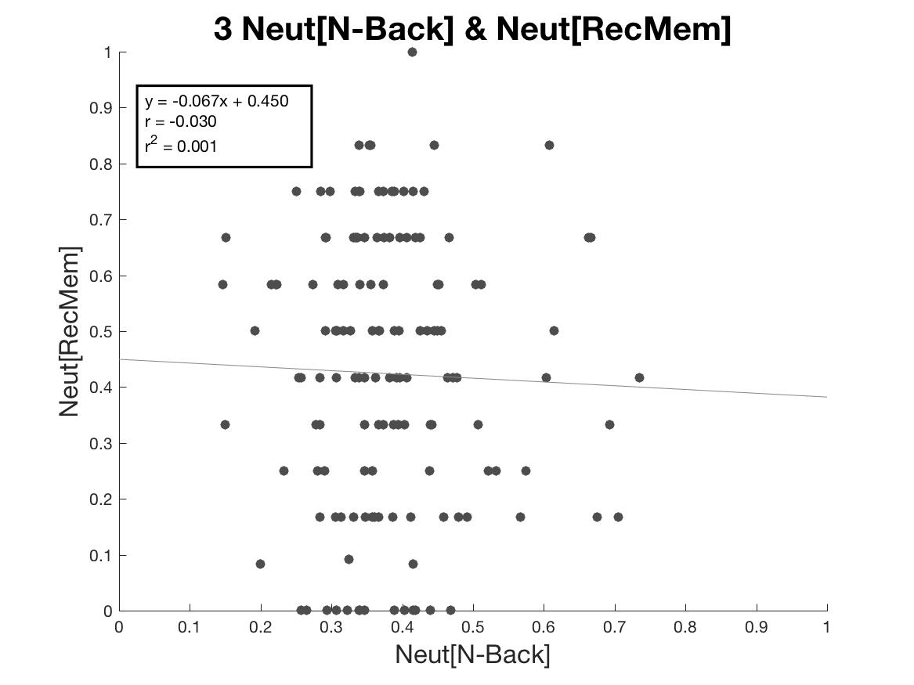
Neut Nback and Neut REC

Slide 4
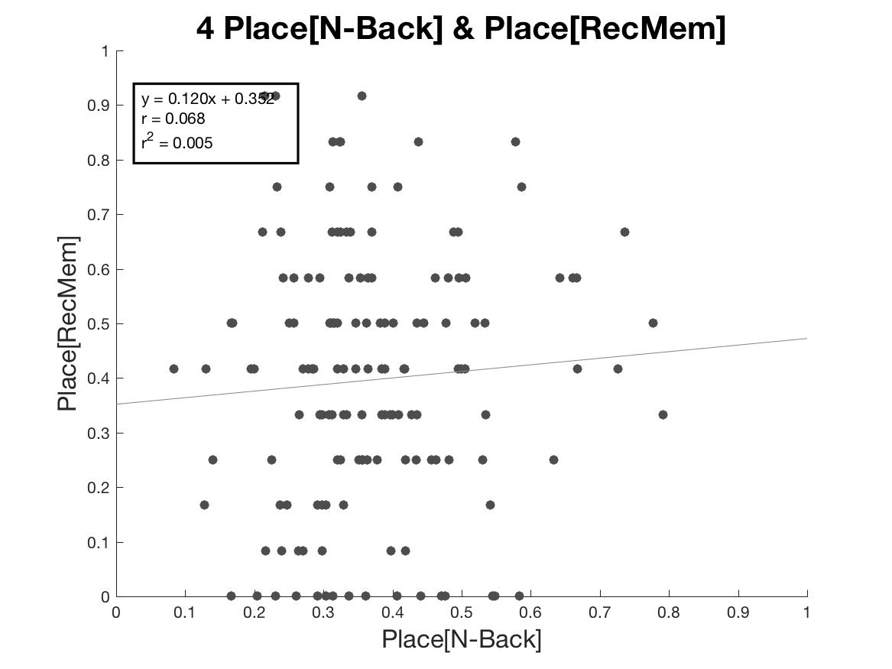
Places Nback and Place REC

Slide 5
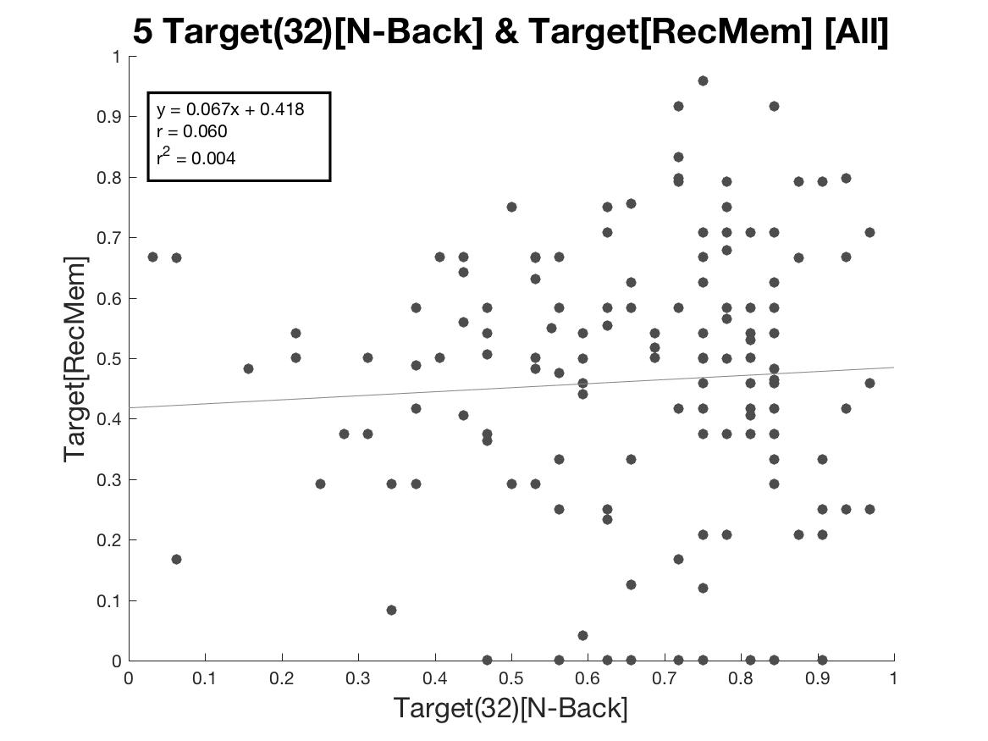
Targets Nback and Targets REC

Slide 6
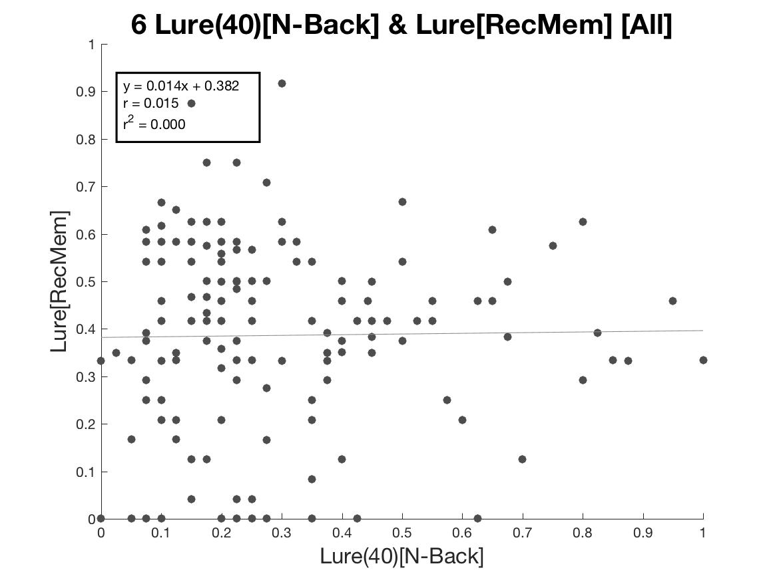
Lure Nback and Lure REC

Slide 7
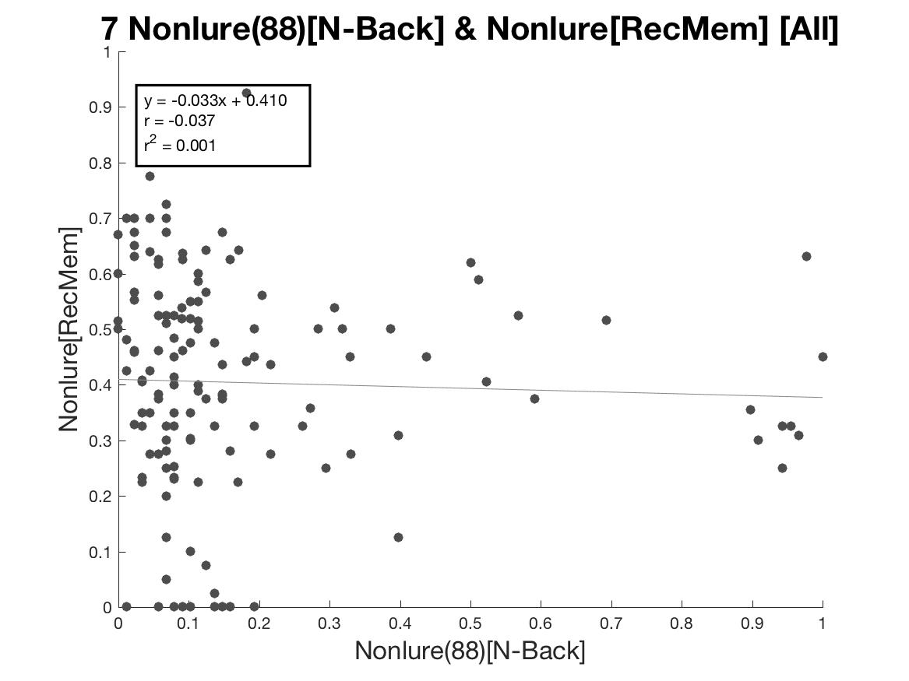
Nonlure Nback and Nonlure RecMem

Slide 8
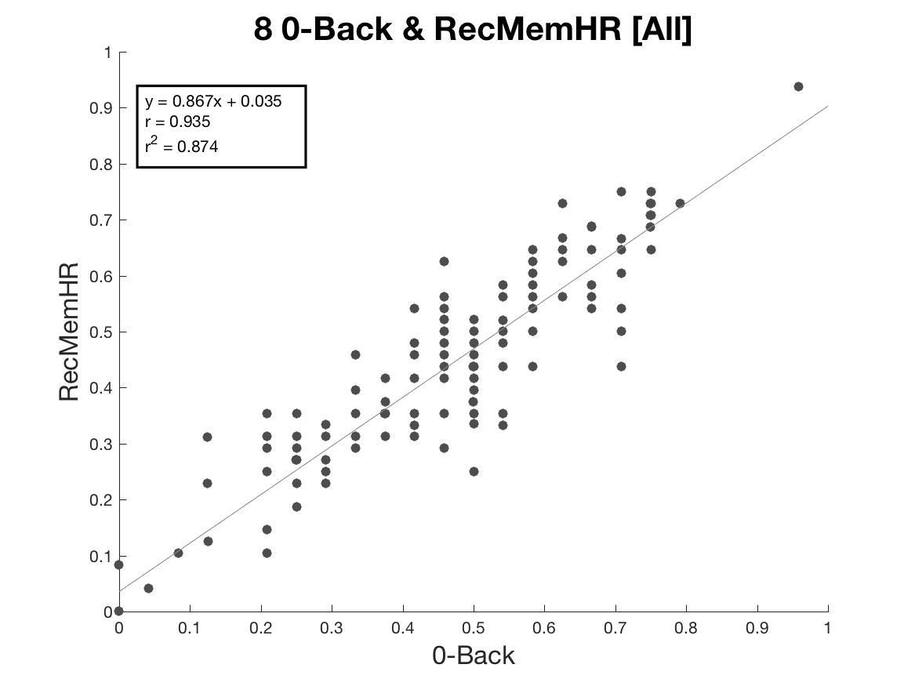
0-Back and REC Hit Rate [All Emotions]

Slide 9
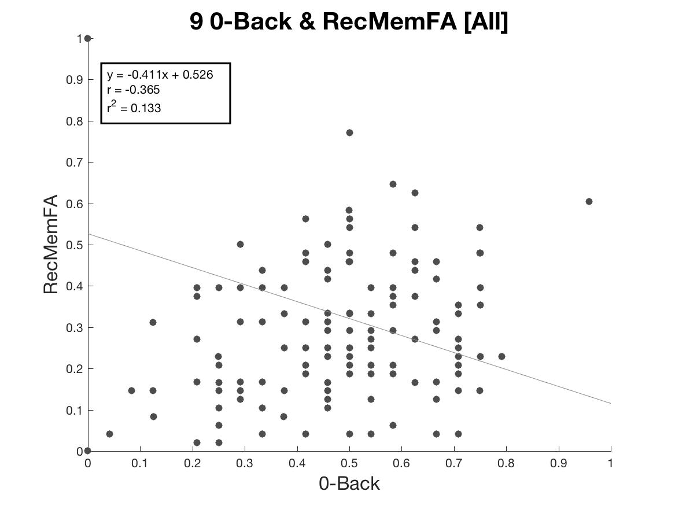
0Back and REC False Alarms [All Emotions]

Slide 10
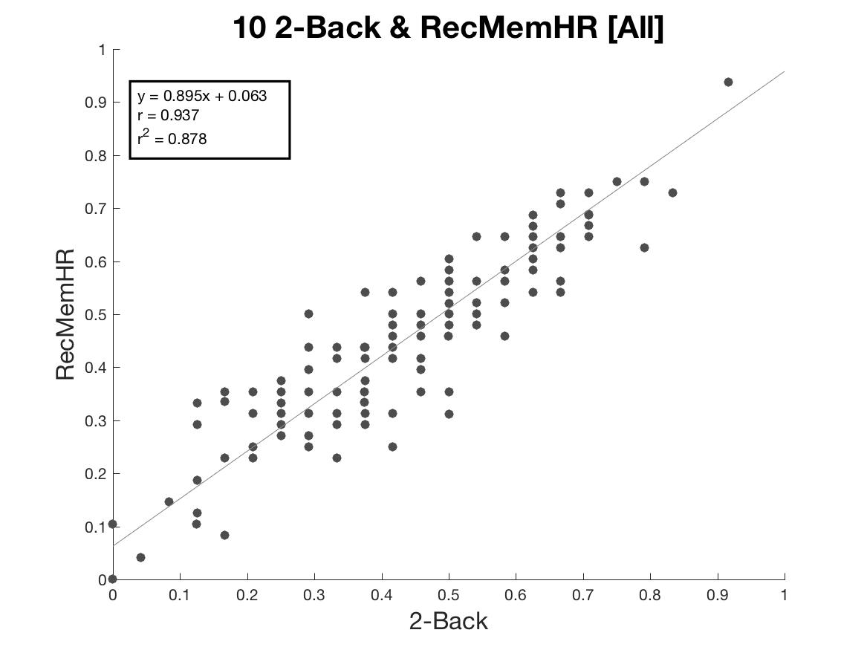
2Back and REC Hit Rate [All Emotions]

Slide 11
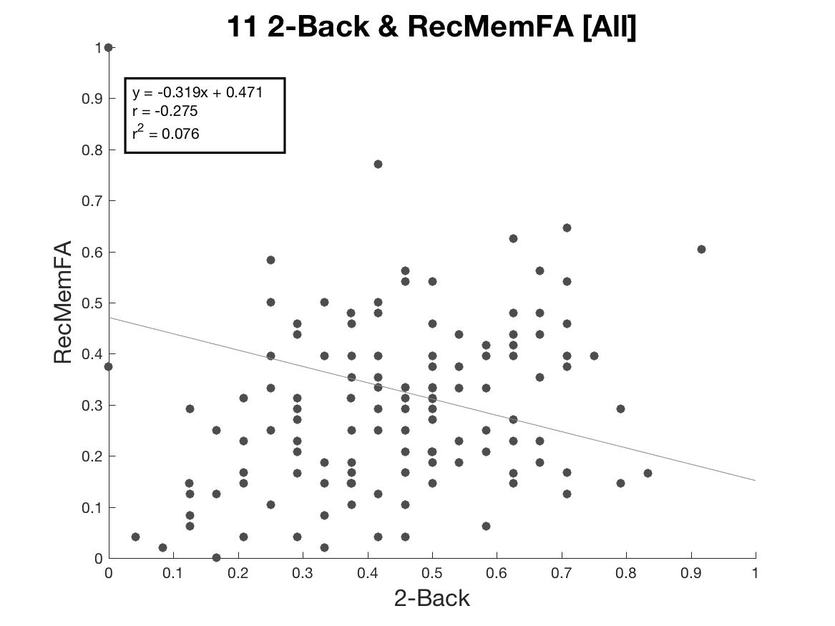
2Back and REC False Alarms [All Emotions]

Slide 12
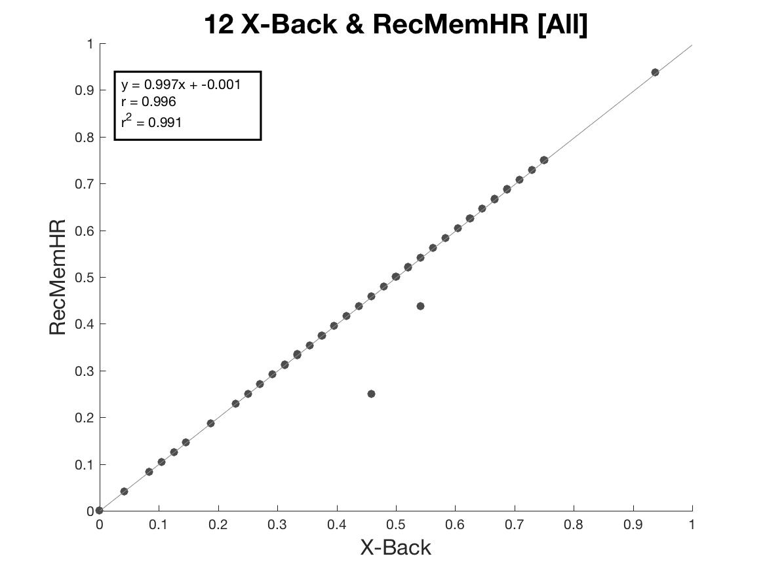
0&2Back and RecMem Hit Rates [All Emotions]

Slide 13
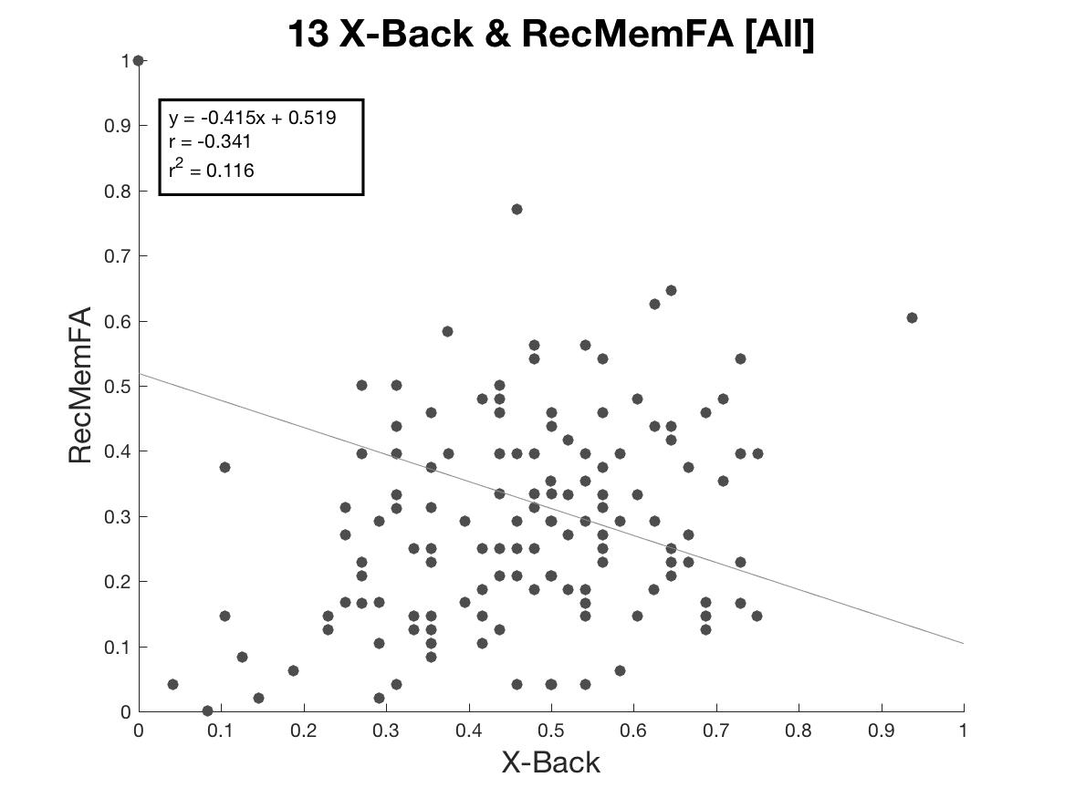
0&2Back and RecMem False Alarms [All Emotions]

Slide 14
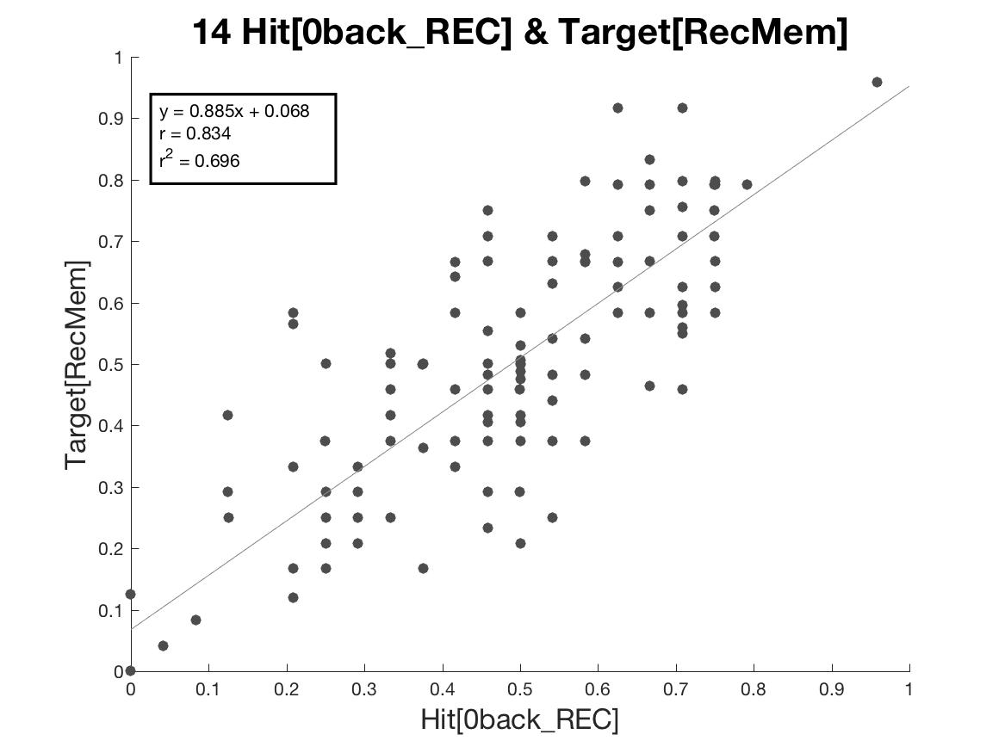
REC w/ 0back stim and REC w/ Target Stim

Slide 15
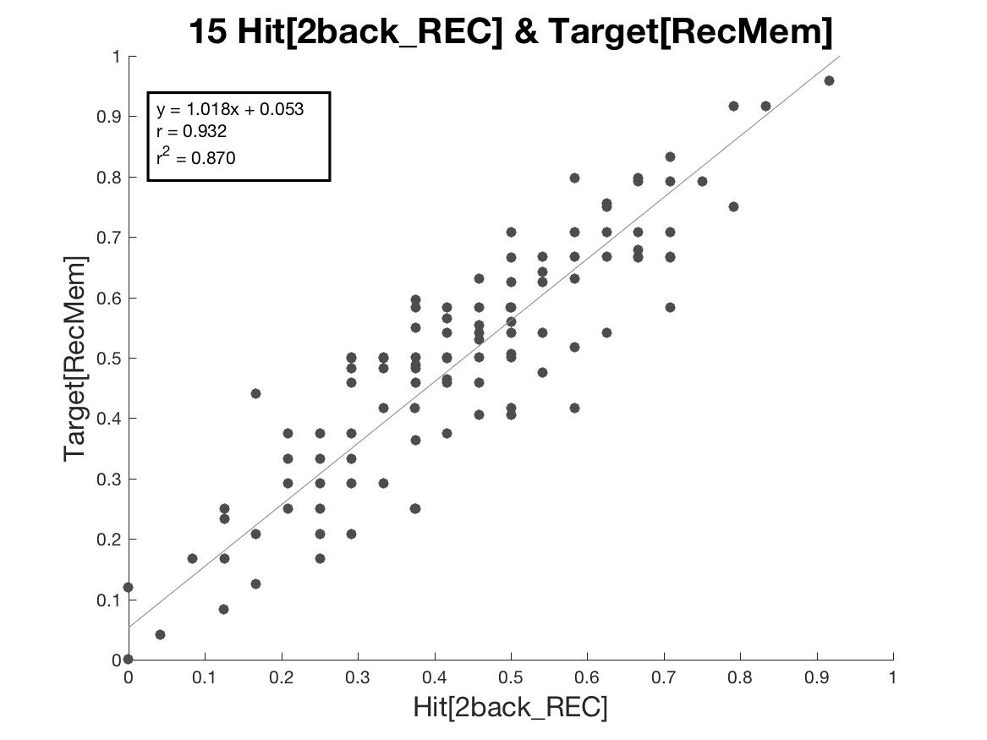
REC w/ 2back stim and REC w/ Target Stim

Slide 16
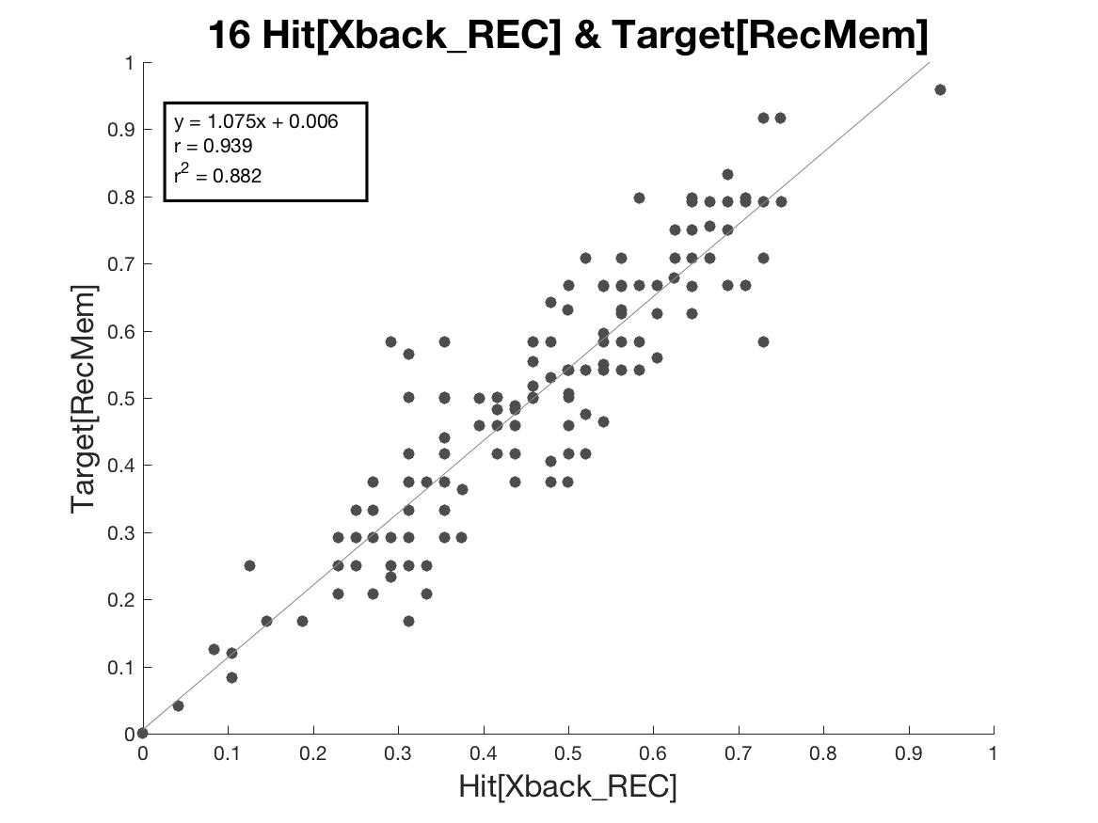
REC w/ 0&2back stim and REC w/ Target Stim

Slide 17
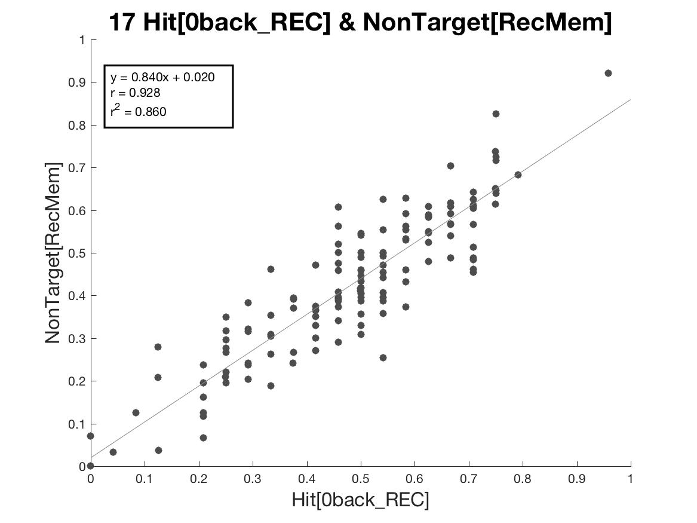
REC w/ 0back stim and REC w/ NonTarget Stim

Slide 18
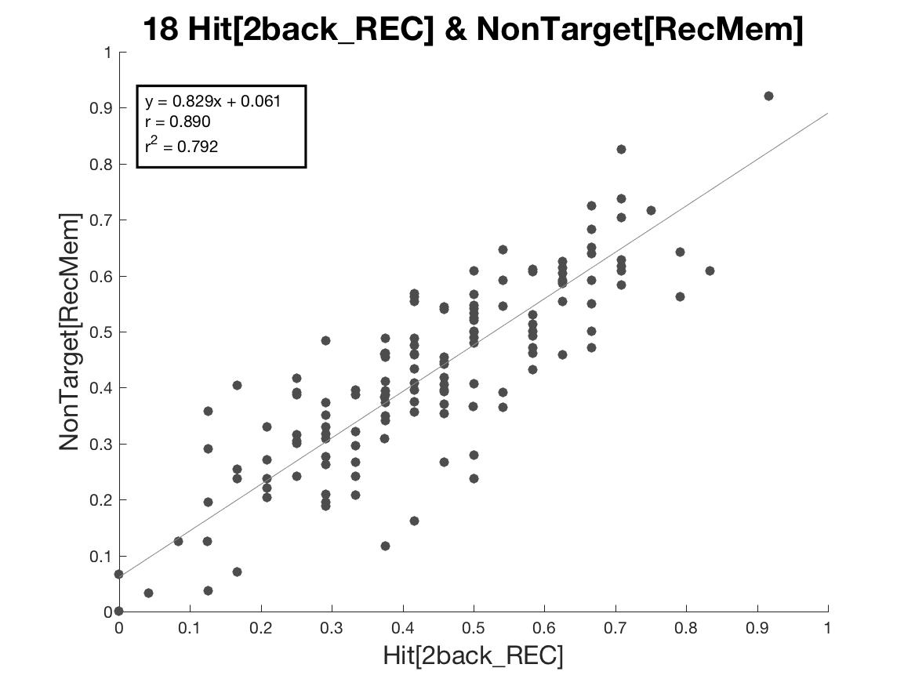
REC w/ 2back stim and REC w/ NonTarget Stim

Slide 19
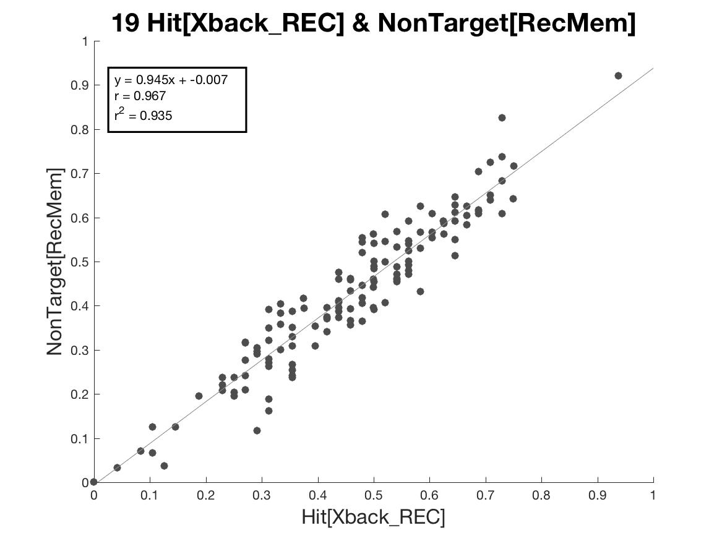
REC w/ 0&2back stim and REC w/ NonTarget Stim

Slide 20
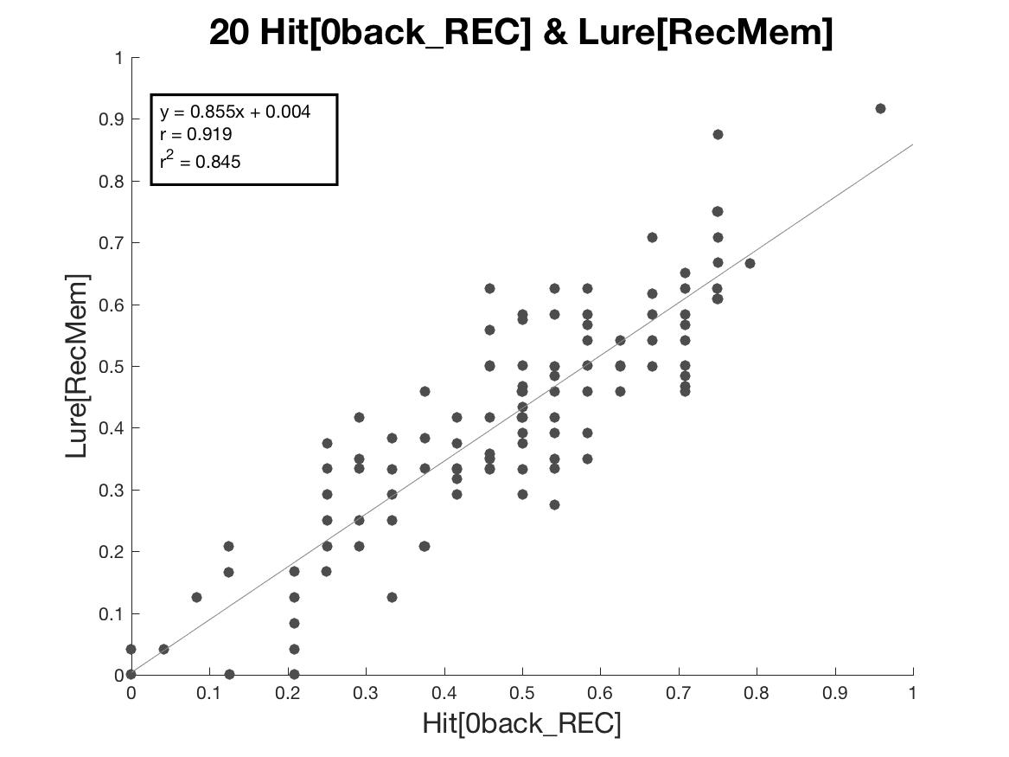
REC w/ 0back stim and REC w/ Lure Stim

Slide 21
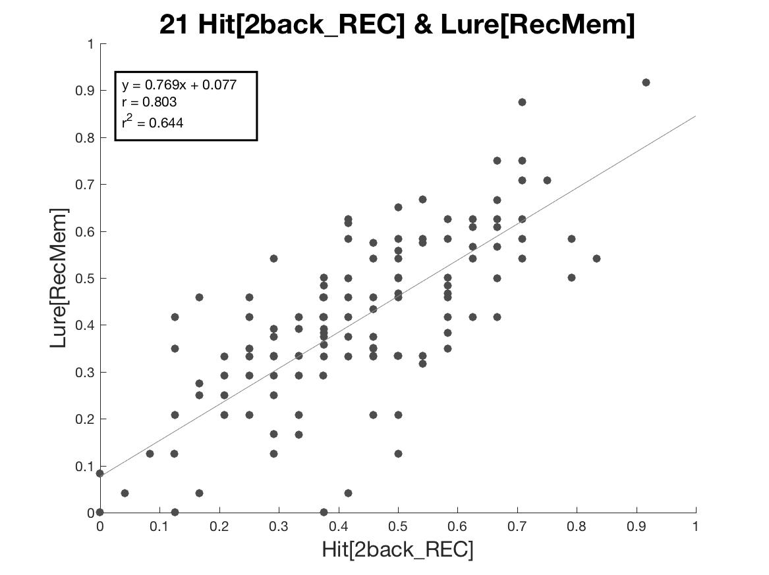
REC w/ 2back stim and REC w/ Lure Stim

Slide 22
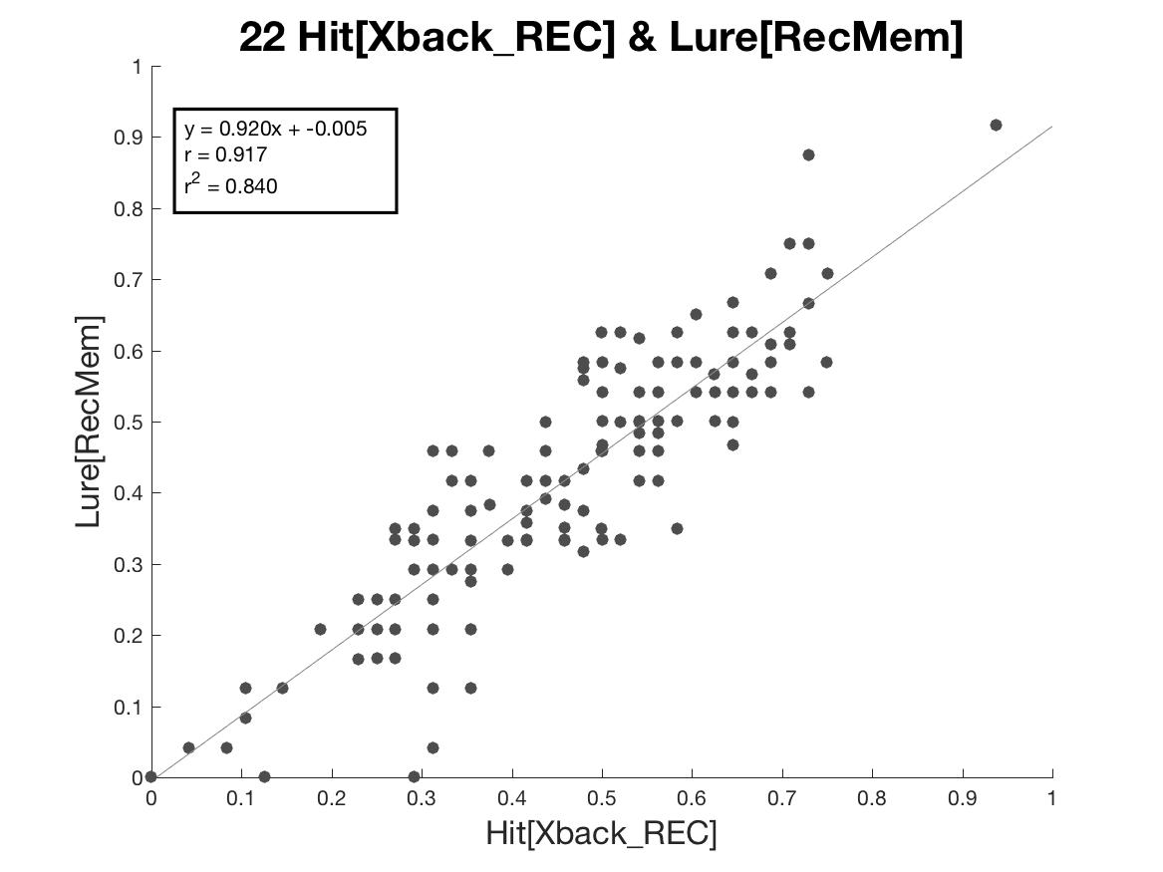
REC w/ 0&2back stim and REC w/ Lure Stim

Slide 23

REC w/ 0back stim and REC w/ Nonlure Stim

Slide 24
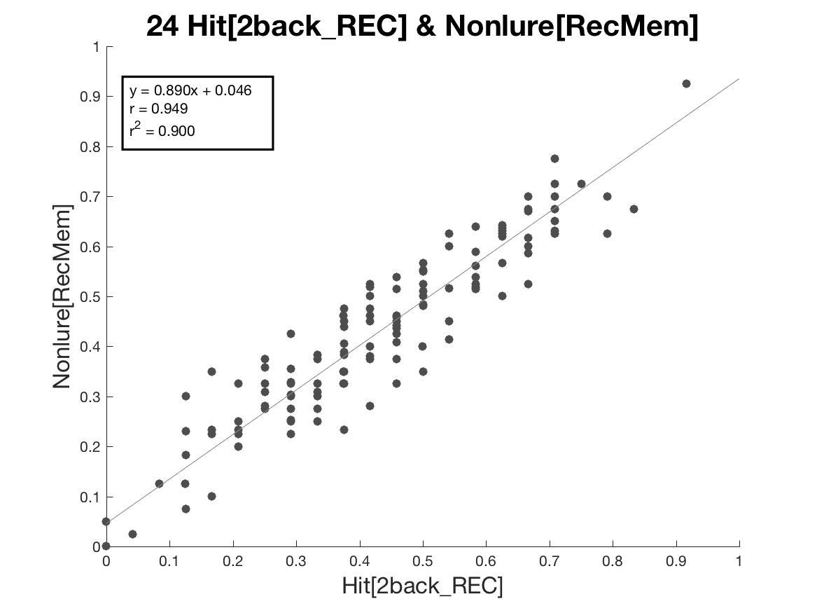
REC w/ 2back stim and REC w/ Nonlure Stim

Slide 25
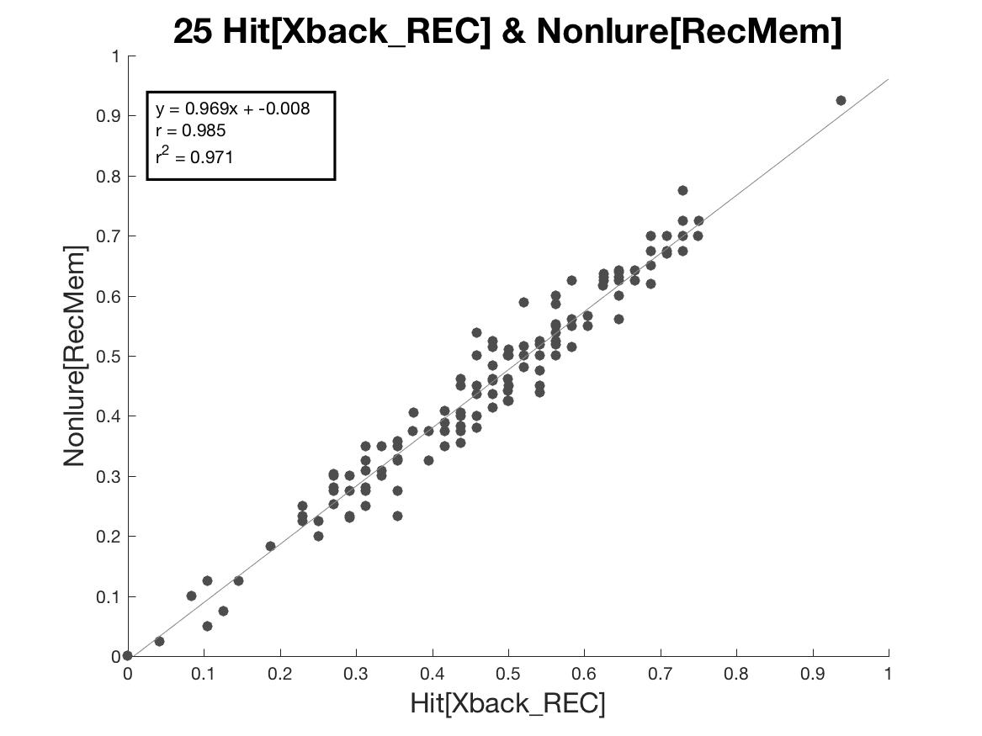
REC w/ 0&2back stim and REC w/ Nonlure Stim

Slide 26
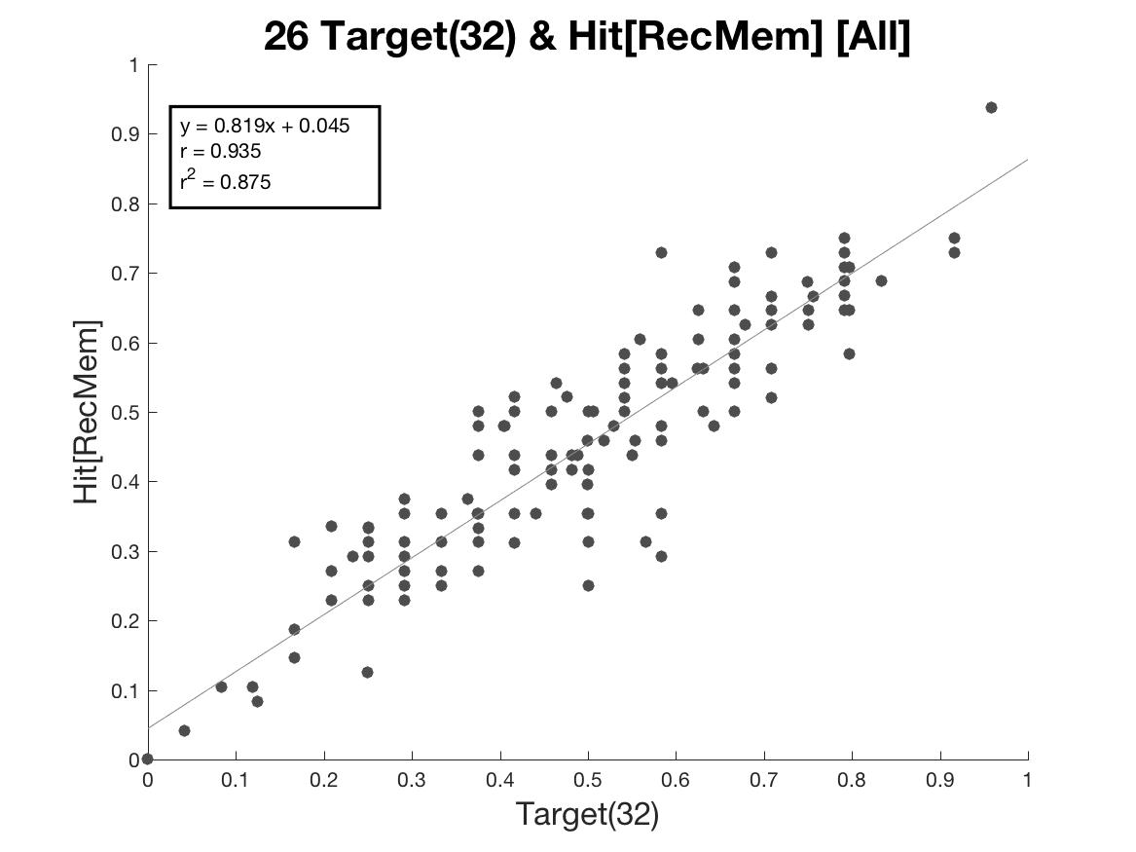
REC w/ Targets(32) and RecMem HitRate

Slide 27
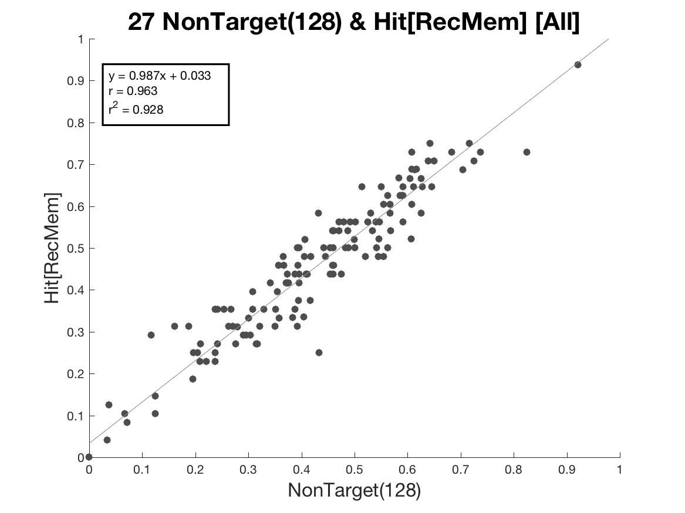
REC w/ NonTargets(128) and RecMem HitRate

Slide 28
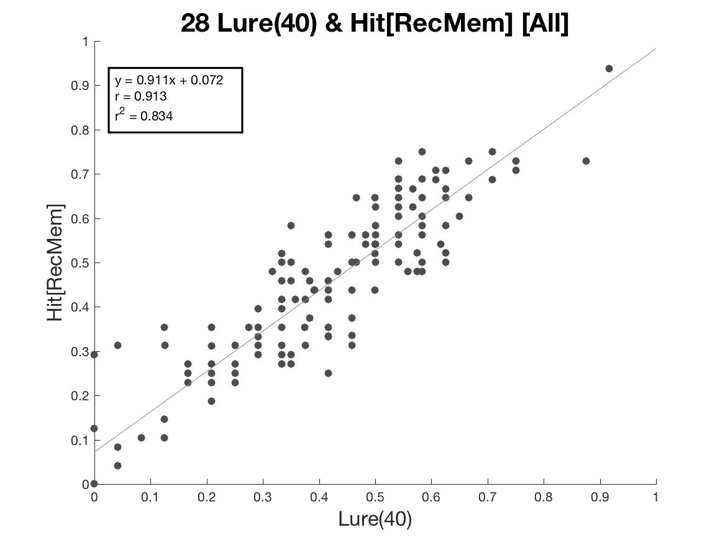
REC w/ Lure(40) and RecMem HitRate

Slide 29
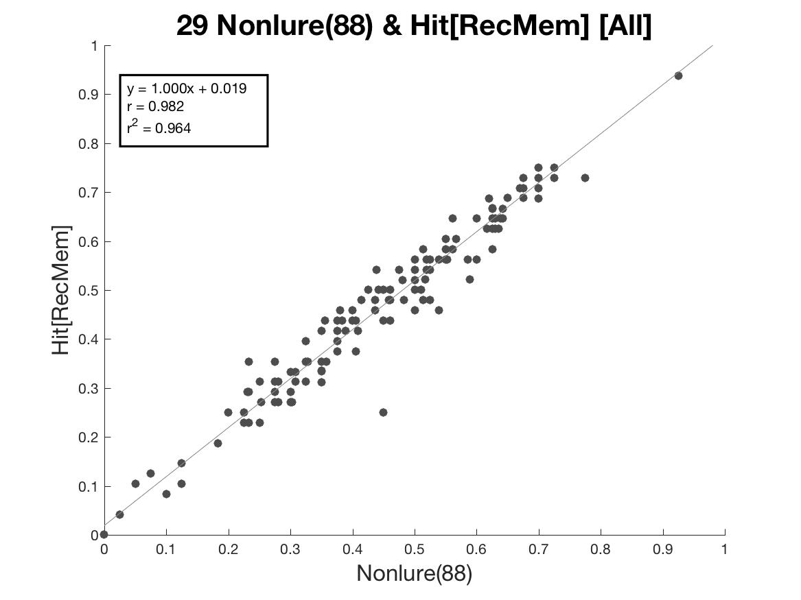
REC w/ Nonlure(88) and RecMem HitRate

Slide 30
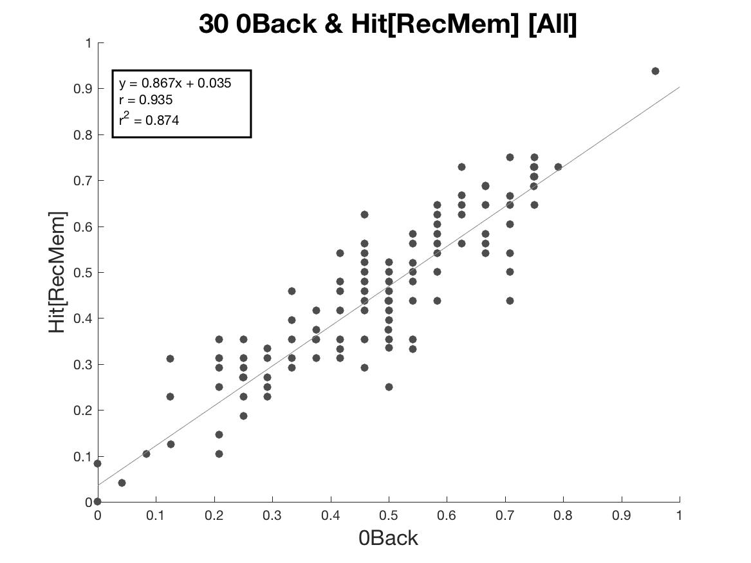
0back Stim in REC and HitRate from REC

Slide 31

2back Stim in REC and HitRate from REC

Slide 32
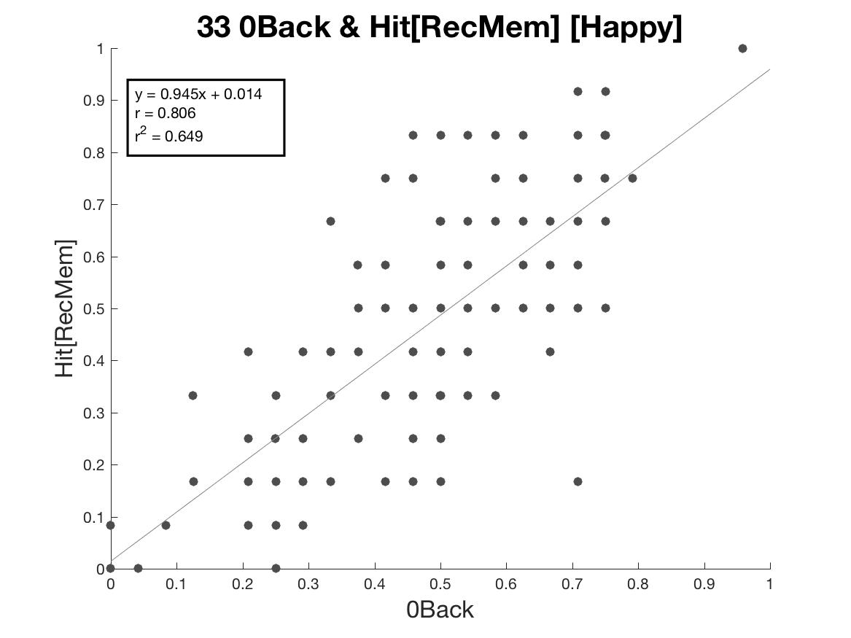
0back Stim in REC and HitRate from REC [Happy Stim]

Slide 33
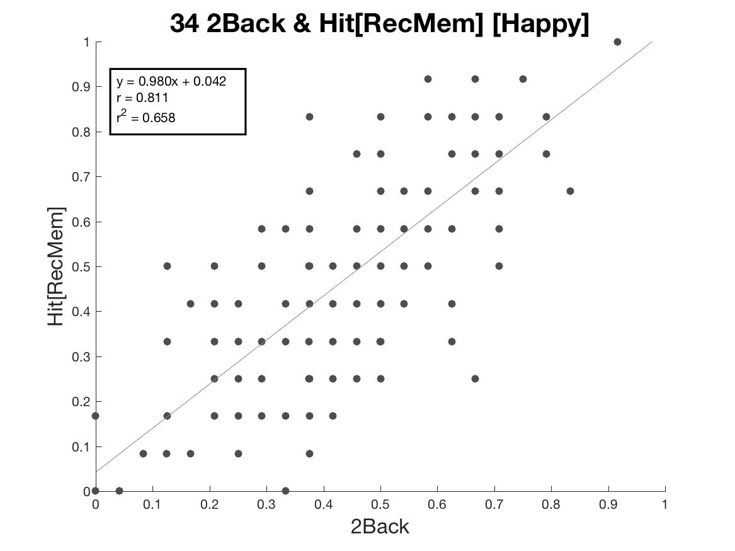
2back Stim in REC and HitRate from REC [Happy Stim]

Slide 34
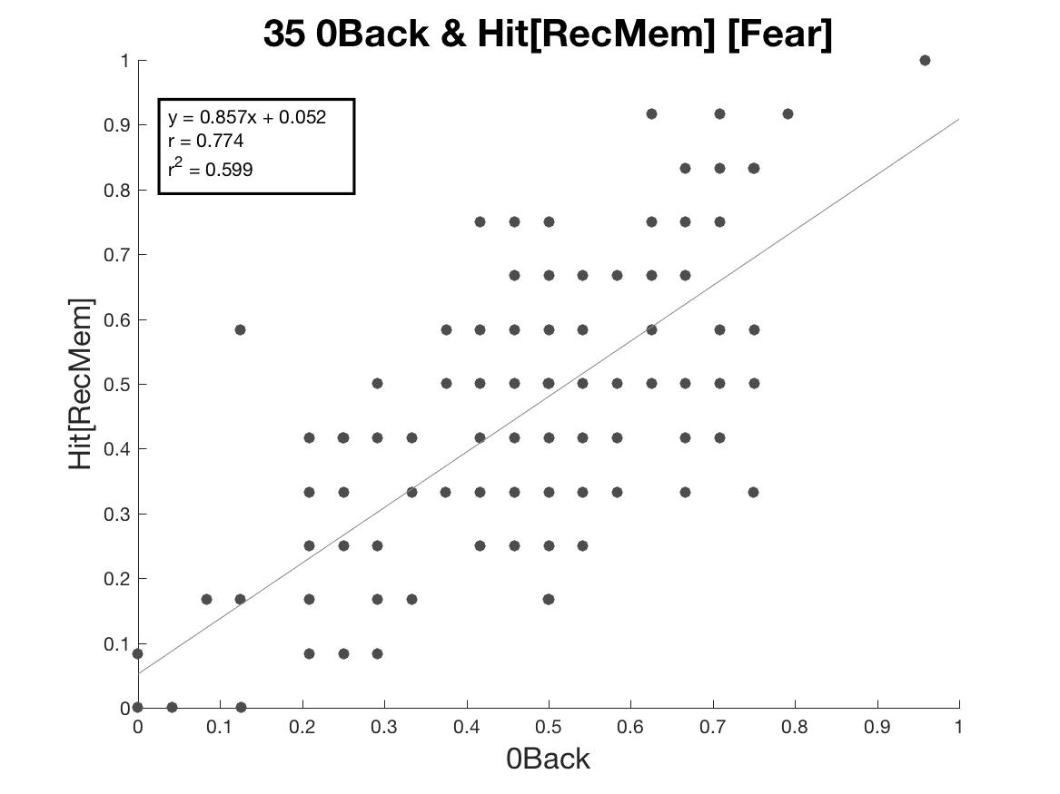
0back Stim in REC and HitRate from REC [Fear Stim]

Slide 35
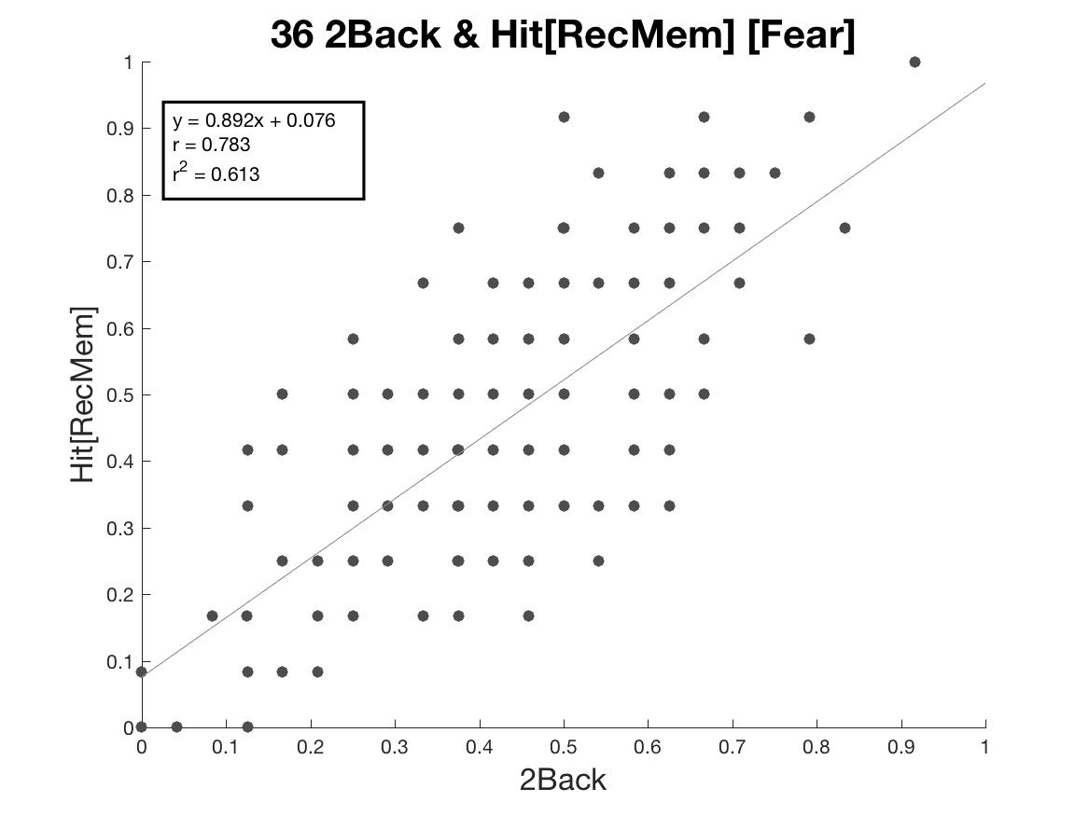
2back Stim in REC and HitRate from REC [Fear Stim]

Slide 36

0back Stim in REC and HitRate from REC [Neut Stim]

Slide 37

2back Stim in REC and HitRate from REC [Neut Stim]

Slide 38
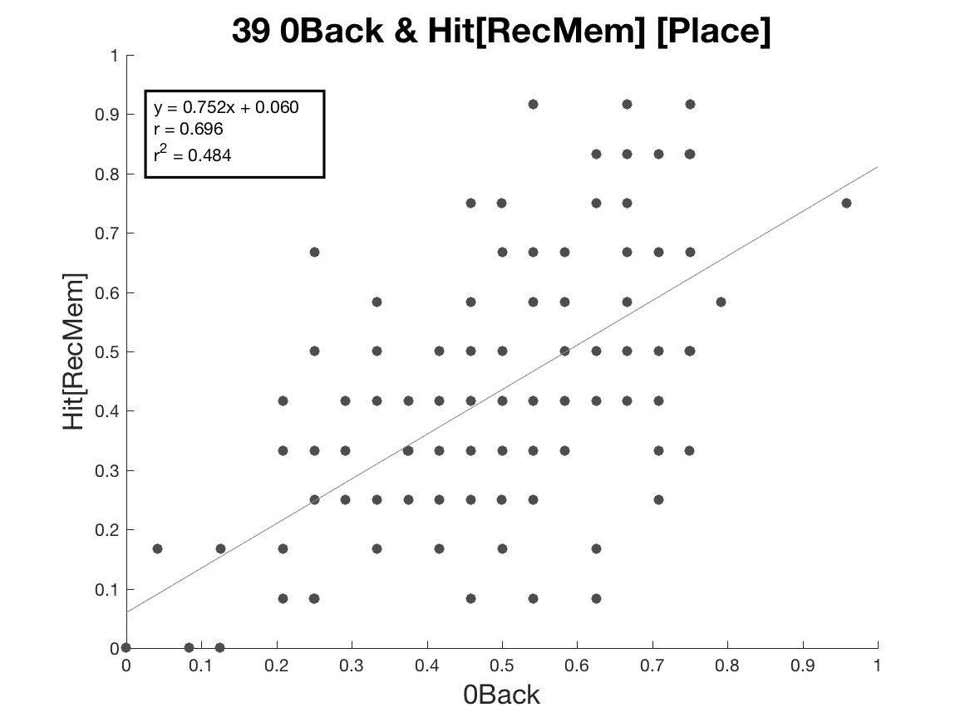
0back Stim in REC and HitRate from REC [Place Stim]

Slide 39
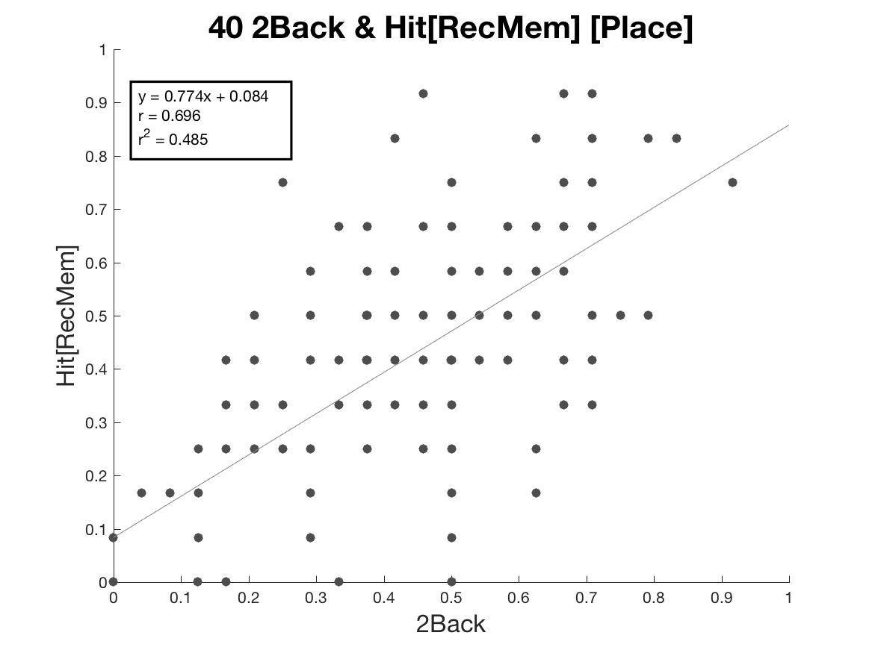
2back Stim in REC and HitRate from REC [Place Stim]

Slide 40
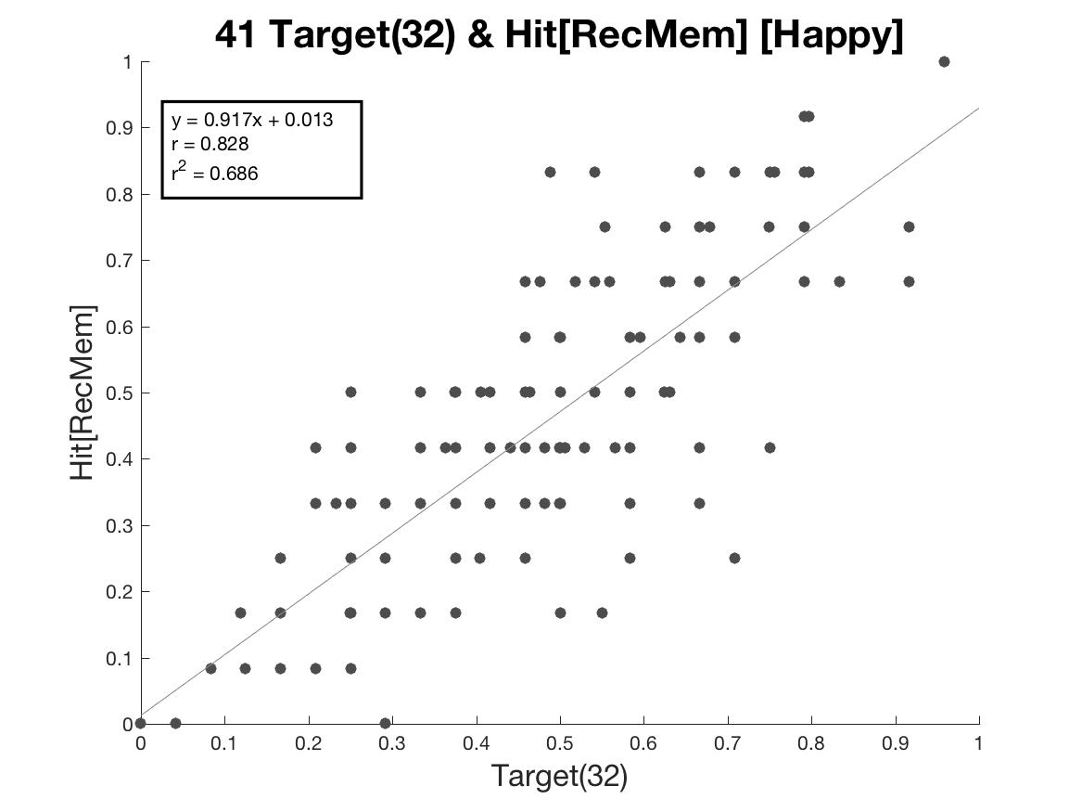
Target Stim in REC and Hit Rate REC [Happy Stim]

Slide 41

Target Stim in REC and Hit Rate [Fear Stim]

Slide 42

Target Stim in REC and Hit Rate [Neut Stim]

Slide 43
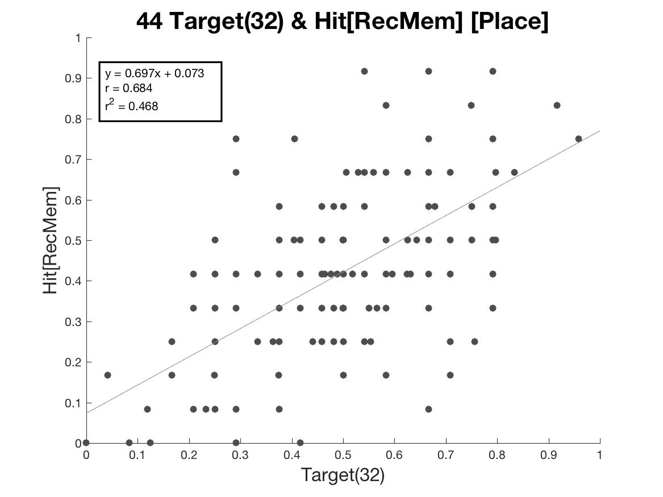
Target Stim in REC and Hit Rate [Place Stim]

Slide 44
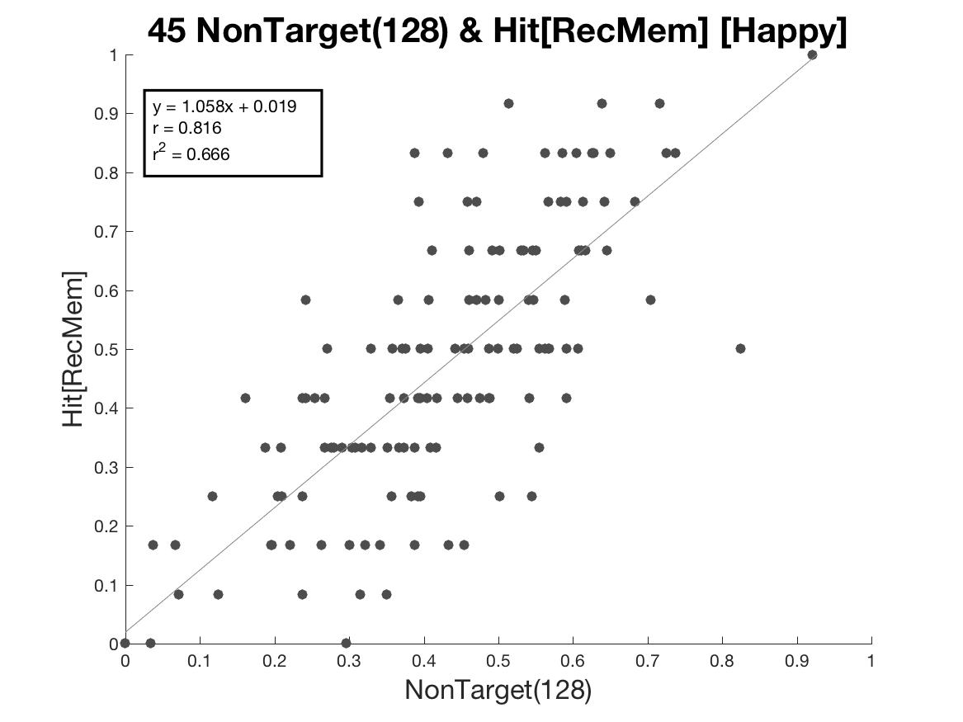
NonTarget Stim in REC and Hit Rate [Happy Stim]

Slide 45

NonTarget Stim in REC and Hit Rate [Fear Stim]

Slide 46
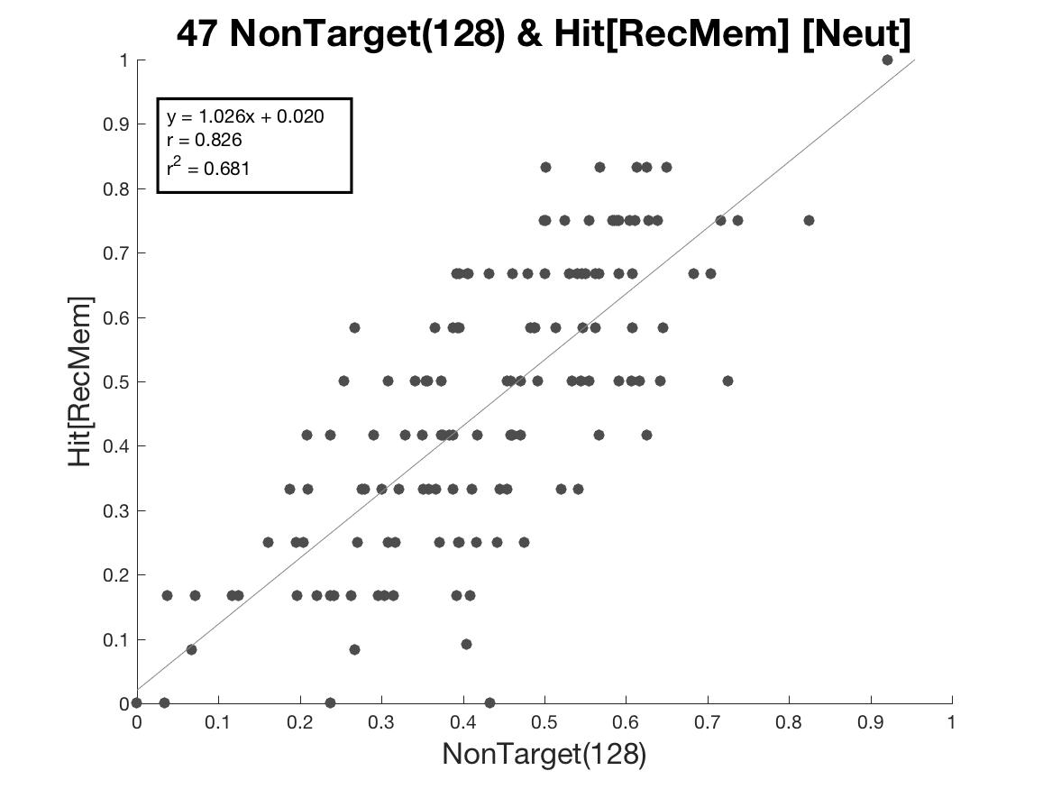
NonTarget Stim in REC and Hit Rate [Neut Stim]

Slide 47
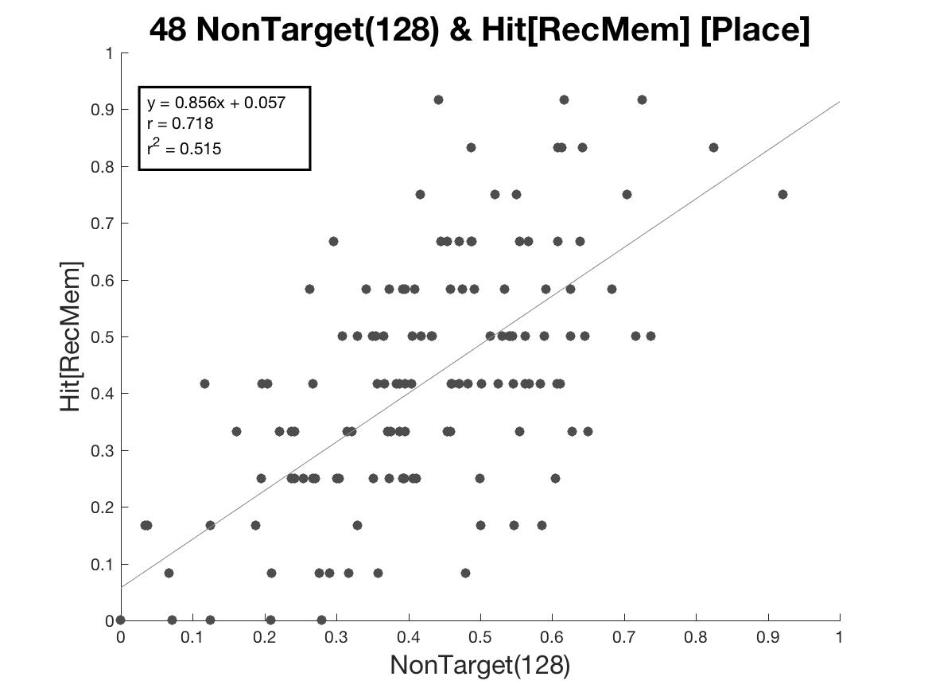
NonTarget Stim in REC and Hit Rate [Place Stim]

Slide 48
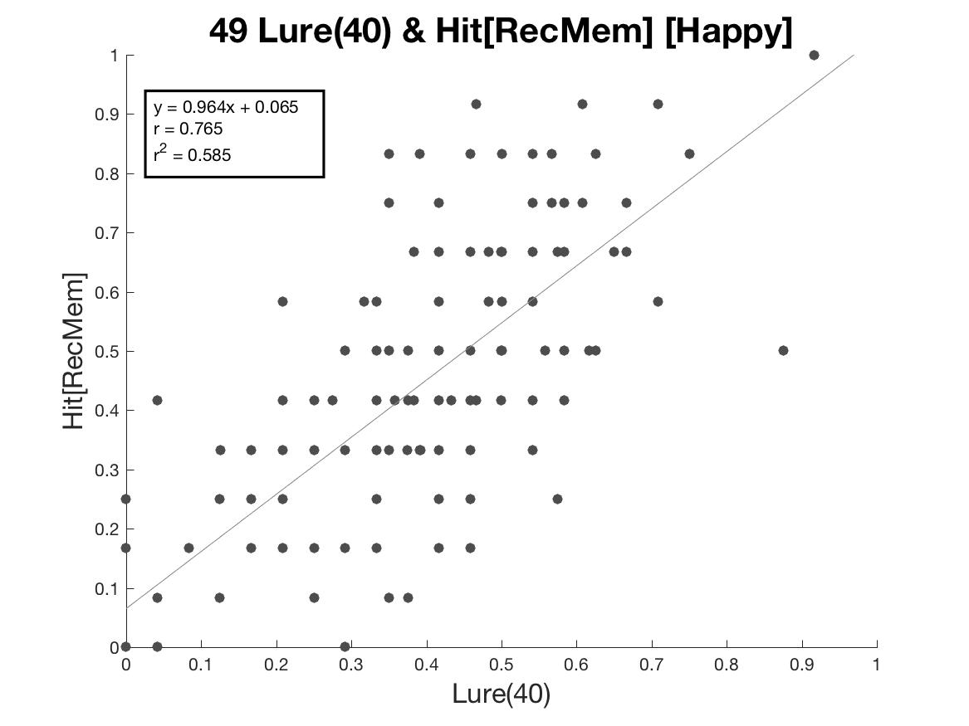
Lure Stim in REC and Hit Rate [Happy Stim]

Slide 49
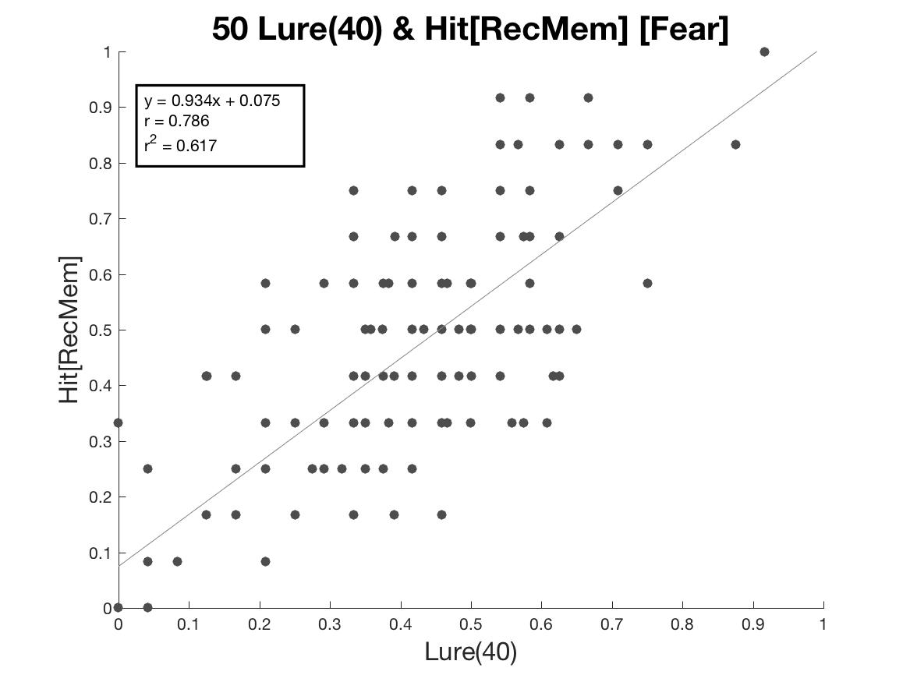
Lure Stim in REC and Hit Rate [Fear Stim]

Slide 50
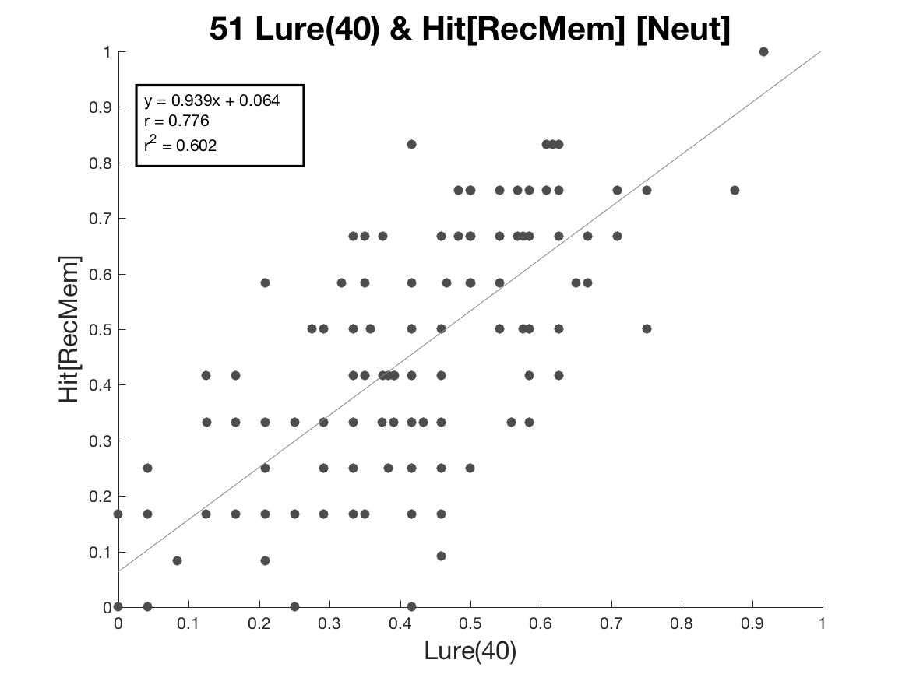
Lure Stim in REC and Hit Rate [Neut Stim]

Slide 51

Lure Stim in REC and Hit Rate [Place Stim]

Slide 52
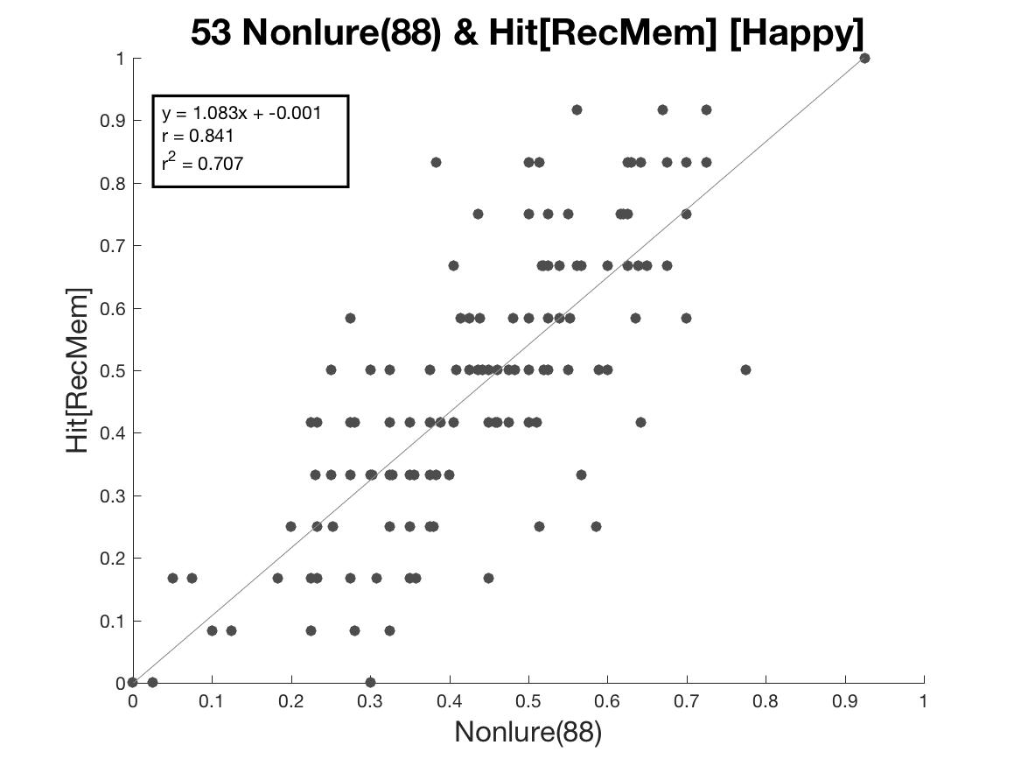
Nonlure Stim in REC and Hit Rate [Happy Stim]

Slide 53

Nonlure Stim in REC and Hit Rate [Fear Stim]

Slide 54

Nonlure Stim in REC and Hit Rate [Neut Stim]

Slide 55
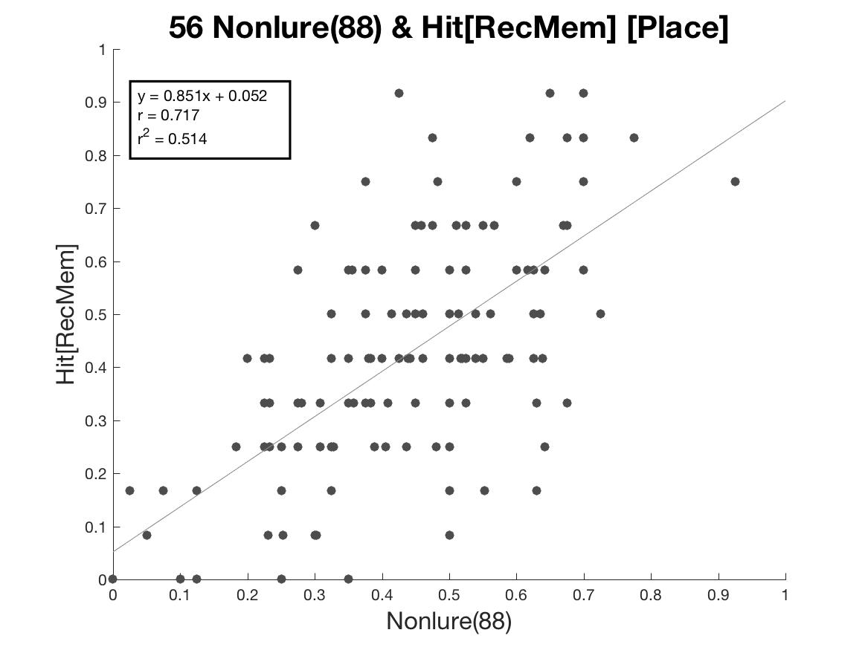
Nonlure Stim in REC and Hit Rate [Place Stim]

